Slide 1
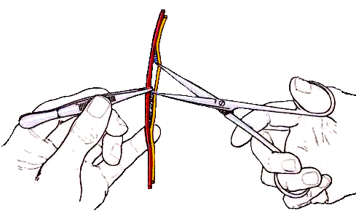
Regional anatomy
山东大学医学院解剖教研室
李振华

Slide 2
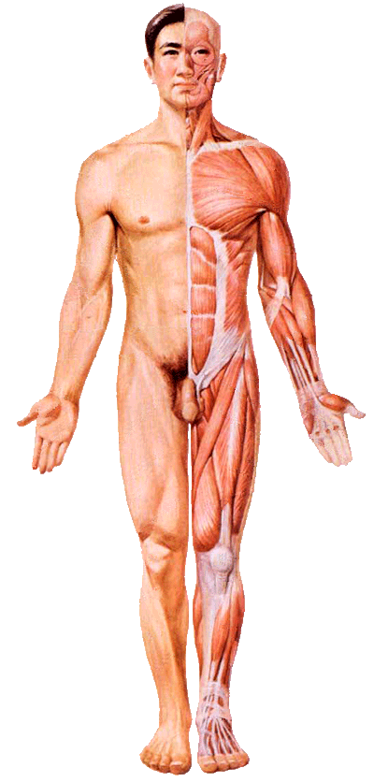
Basic Concepts of Anatomy
Definition: dealing with the form, position, and relationship of the structures of several systems located in a particular region of body
Parts of the body
  Head
  Neck
  Thorax
  Abdomen
  Pelvis and perineum
  Upper limb
  Lower limb

Slide 3
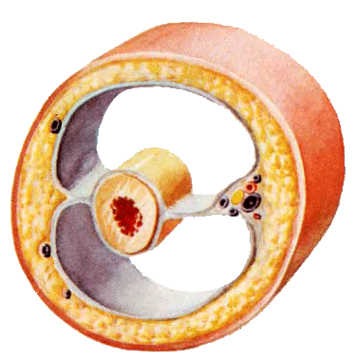
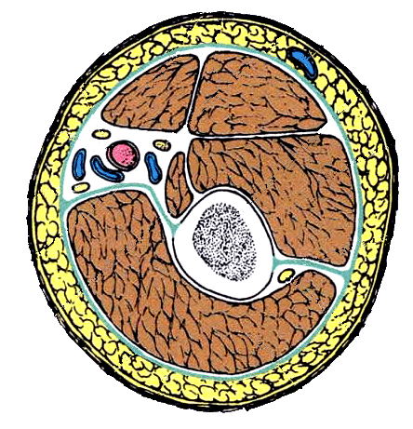
Basic structures of the human body
Skin
Superficial fascia
Deep fascia
Muscles
Blood vessels
Lymphatic vessels
Nerves

Slide 4
Abbreviations of terms
a., aa. artery, arteries
ant. anterior
f. fibre or fiber
inf. inferior
lig. ligament
ln. lymph node
m., mm. muscle, muscles
n., nn. nerve, nerves
post. posterior
sup. superior
v. vein

Slide 5


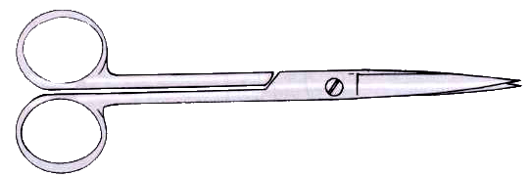
Instruments used for dissection
Two pairs of forceps
A scalpel
A pair of scissors

Slide 6
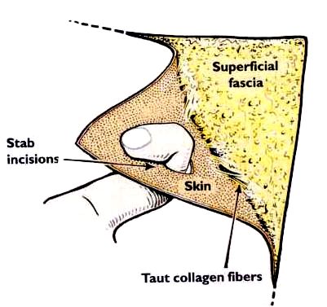
Dissecting techniques
When removing skin, apply traction

Slide 7
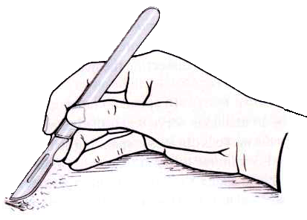
Dissecting techniques
When dissection, rest the hand.
Elimination unsteadying movements.

Slide 8
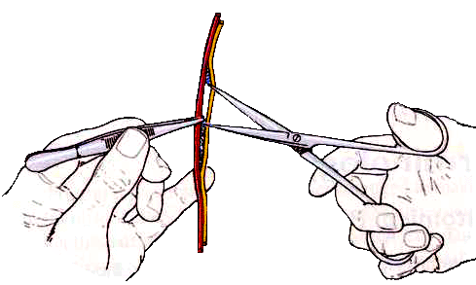
Dissecting techniques
Scissors technique separating delicate structures

Slide 9
局部解剖教学特点
局部解剖学的教学包括讲授和实地解剖。主要讲授各系统的总论和各解剖操作区的重点内容。实地解剖采取分组形式，在教师指导下，按照解剖操作指导，参照图谱由学生亲自动手解剖尸体，部分内容观察标本和模型。同时，密切结合活体的观察和触摸，并适当的结合一些临床病例讨论以增强对解剖学内容的理解和记忆。
教学大纲所列教学内容按要求程度的不同，分为“掌握内容”和“了解内容”两级。掌握内容为重点内容，学生必须通过反复学习与思考达到牢固掌握、熟练描述、准确指认和联系实际应用的程度。了解内容则要求学生达到一般的认识和了解。

Slide 10
Examination
Identify 20 structures (30 marks)
Written examination
  35 single-choice questions (35 marks)
  15 multi-choice questions (15 marks)
  4 short answer questions (20marks)

